Slide 1
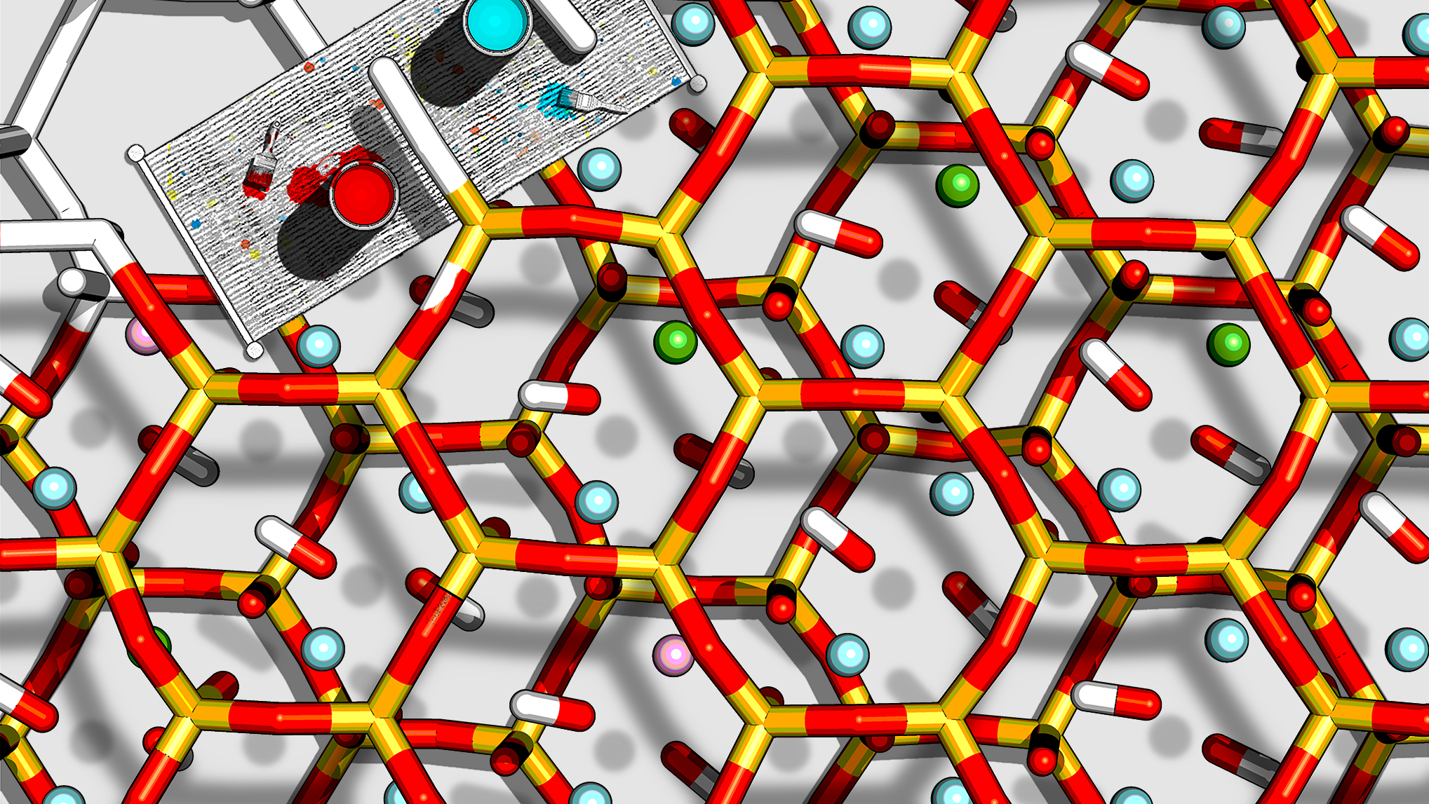
Computational Techniques in Chemistry
Valentina Erastova
University of Edinburgh
January 2025
Session 1: Introduction to Linux and command-line

Slide 2
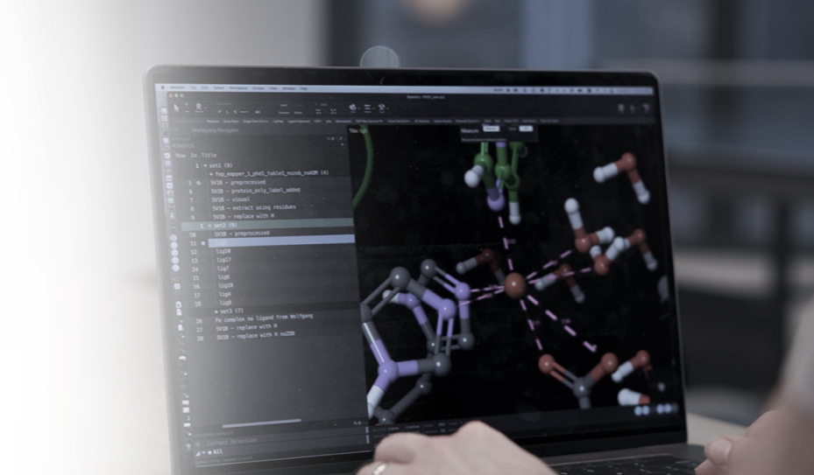
What is computational chemistry?
Computational chemistry aims to simulate and predict molecular structures and properties using different kinds of calculations based on quantum and classical physics.
Computational techniques are methods and tools with which we perform these calculations.

Slide 3
Why attend this course?
Computational techniques are integral part of modern research, contributing to scientific discovery.
Enable accurate simulation of chemical reactions and prediction of molecular properties, otherwise unattainable.
E.g., study of large protein complexes, biological membranes, molecular interactions, and extreme conditions.
Computational tools accelerate the development of new drugs, materials, and technologies.
It is now essential for a modern chemist to have basic skills and understanding of the computational techniques.

Slide 4

What will I learn?
Practical Aspects: Understand the practical aspects of molecular simulations.
Command-Line Interfaces: Use basic command-line interfaces and operate on high-performance computing resources.
Computational Chemistry Software: Use common computational chemistry packages to tackle real chemical problems.
Molecular Dynamics Simulations: Prepare systems for molecular dynamics simulations and troubleshoot the set-up, simulations, and analysis steps.
Technique Limitations: Understand the limitations of the computational chemistry techniques used.
Reporting: Report the methodology and observations in a condensed written format.
Group Work: Perform group work, encouraged and developed through the practicals.

Slide 5


Computational Chemist 🧑‍🔬
Examples of Computational Chemistry Careers
… use of computational tools to solve chemical problems across various industries/topics
Superpowers 💪:
Proficiency in computational tools
Problem-solving skills
Interdisciplinary collaboration
Academic Research 📚
Environmental Science 🌍
Conducting research in universities or research institutions, focusing on theoretical and computational methods to solve chemical problems.
Universities, Research Institutes
Applying computational chemistry to understand and solve environmental issues, such as pollution and climate change.
Environmental Agencies, NGOs
Pharmaceutical Industry 💊
Material Science 🛠
Developing computational models to aid in drug discovery and development processes.
Pharmaceutical Companies, Biotech Firms
Using computational methods to design and discover new materials with desired properties.
Material Science Companies, Research Labs
Skills:
Strong analytical skills
Programming
Data Analysis
Publication writing
Skills:
Environmental modeling
Data analysis
Interdisciplinary knowledge
Skills:
Knowledge of molecular modeling
Bioinformatics
Software development
Skills:
Expertise in materials science
Computational modeling
Simulation techniques
Full article: https://www.acs.org/careers/chemical-sciences/fields/computational-chemistry.html

Slide 6
Course organisation
Monday/Tuesday
Thursday/Friday
Week 1
Introduction to Linux and command-line
Workshop
Drop-in
Quiz 1 (5%)
Week 2
Introduction to molecular dynamics simulations
Workshop
Drop-in
Quiz 2 (5%)
Week 3
Molecular simulation set up of system with an interface or a protein system
Workshop
Drop-in
Week 4
Beginning of the individual projects (30% of the course mark)
Workshop
Drop-in
Week 5
Drop-in
Project Submission

Slide 7
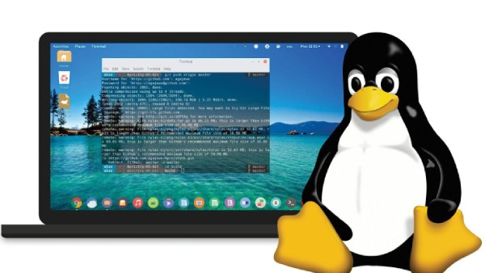
Session 1: Introduction to Linux and command-line

Slide 8
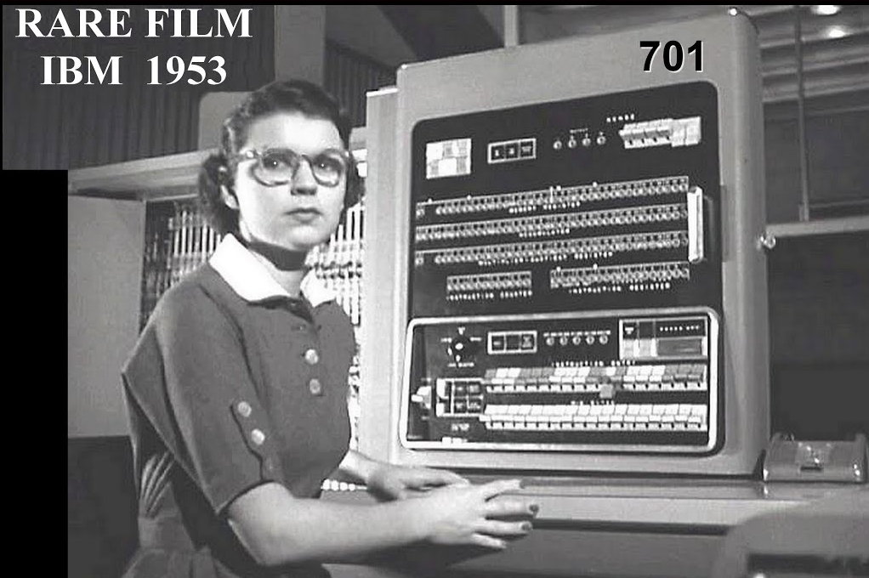
Historical Perspective
1966
Robert Mulliken wins the Nobel Prize in Chemistry
1990s
CompChem adopted by industry and pharma
1927 Heitler and London performed QM calculation of H₂ molecule by hand
2020s
AI-driven models
1990s
DFT development allows for efficient calculations
1950/60
first CompChem programs are developed, allow for automation & analysis
2010s
GPUs + ML
1930
‘40
‘50
‘60
‘70
‘80
‘90
2000
‘10
‘20
‘30
1970s
advancement in models;
Gaussian software released
2000s
Rise of HPC + hybrid techniques for study complex systems
1952
IBM 701
2030s
quantum computing possible?
1980s
standardised software, e.g., AMBER and CHARMM + affordable computing power
Notes:
Comp chem has routes in theoreticl chem, that begin developing in early 20th century
1950s rise of comp power, allows for simulations of first molecular orbitals.
Mulliken for “fundamental work concerning chemical bonds and the electronic structure of molecules”
Gausian is by John Pople,w hwo got Nobel Prise in 1998 for his theory work
Hybrid tech = QM/MM

Slide 9

Why the Unix Shell?
shell is a command-line interpreter or shell that provides a command-line user interface for Unix-like operating systems (that run our HPC).
Automates tasks
Streamlines data management and enables reproducibility
Gives access to enhanced computing power
Facilitates collaborations
Notes:
beyond basic file management: pipeline processing, automation of repetitive tasks, batch processing of large datasets
interfacing directly with both software and databases commonly used in scientific research
Allows to manage large datasets, sharing both datasets and scripts to generate/analyse them with colleagues

Slide 10
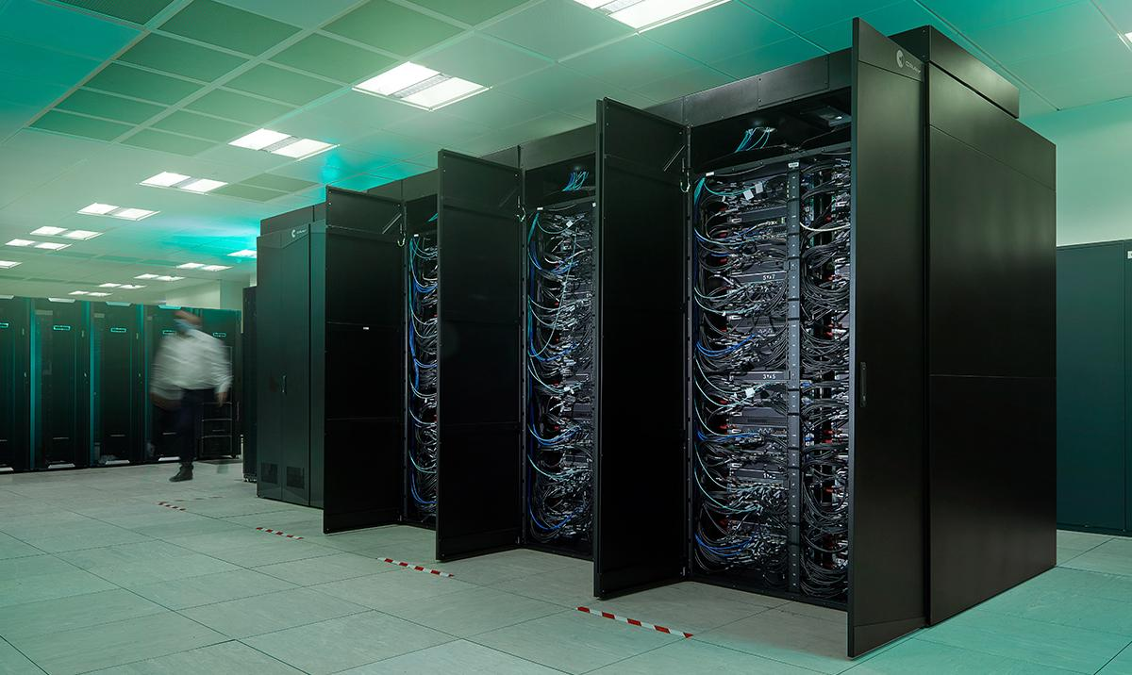
Why use High-Performance Computing?
🔬 Handling Large-Scale Simulations
simulate 100+k atom systems
⏱️ Accelerating Computational Processes
run time-intensive calculations
🎯 Enhancing Accuracy and Precision
perform repeats and high accuracy calculations
🚀 Enabling Advanced Research Techniques
access high-resource novel methods, e.g. QM or ML
🤝 Fostering Collaborative Research
collaborate on large-scale projects across universities

Slide 11

Getting Started with Workshop

Slide 12
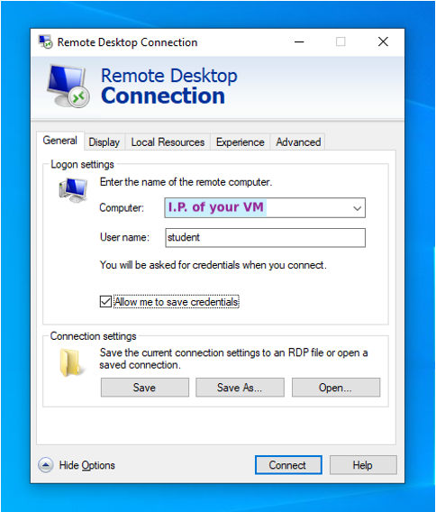

Connecting to your Virtual Machine
Log into the computer in front of you
Open "Remote Desktop Connection" App
In the app click "Show Options"
Enter the IP address of your VM
Enter the username assigned to you, e.g. student
Tick the box for "Allow me to save credentials”

Slide 13
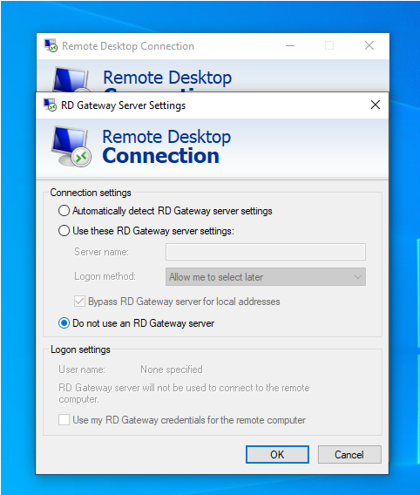
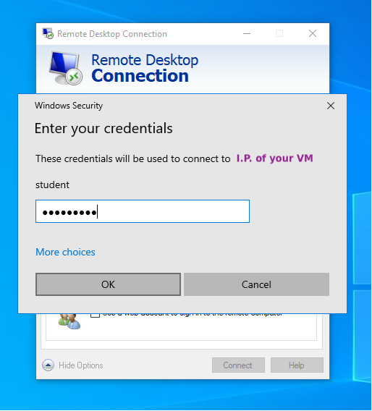
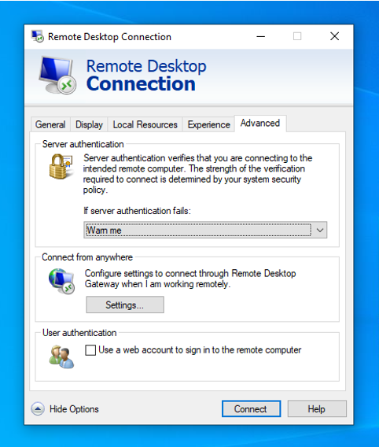
Connecting to your Virtual Machine
Go to the "Advanced" tab
Click "Settings" under "Connect from anywhere”
Click "Do not use an RD Gateway server" and "OK”
Click "Connect”
When prompted to enter credentials, enter the password, e.g., dragonfly

Slide 14
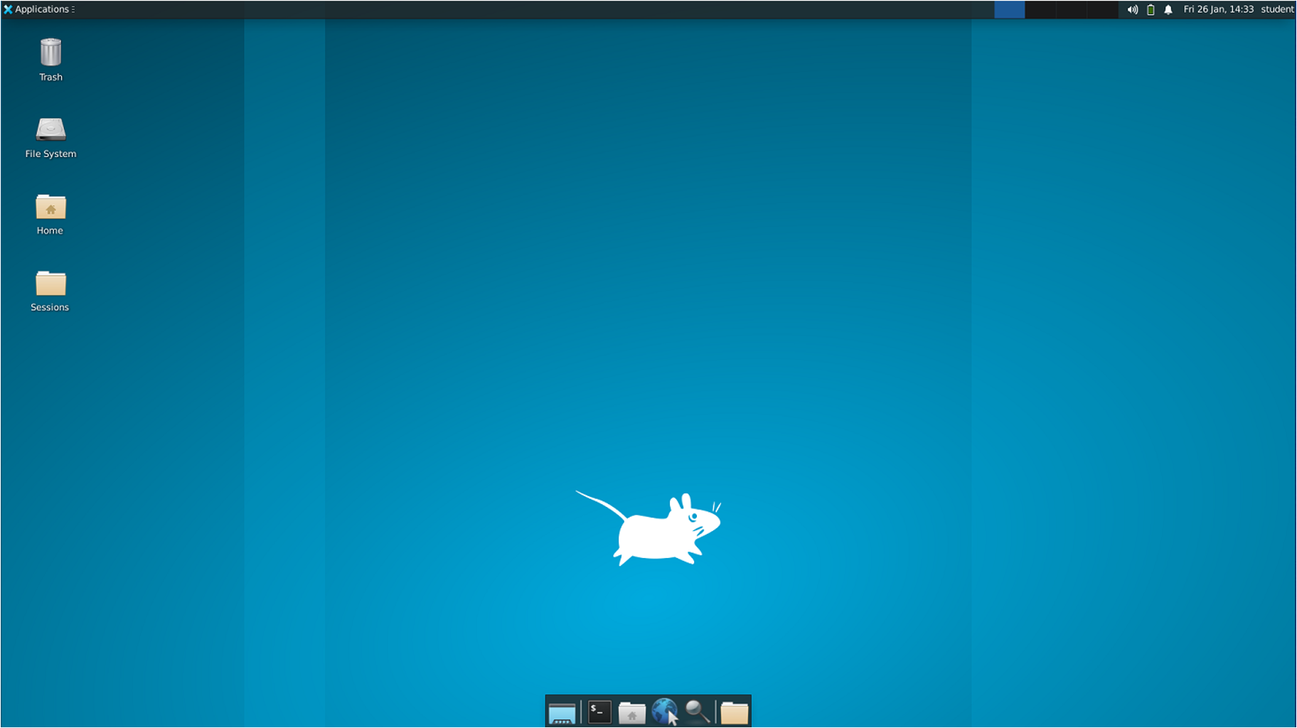
Connecting to your Virtual Machine
Success!
You may have an ‘Authenticate’ window pop up. Cancel it – it is not important.

Slide 15


Click the >_ icon to load the Terminal app
The terminal window will open
You will be prompted for UNN and password – enter your university one.
Starting with the Workshop

Slide 16
Click the >_ icon to load the Terminal app
The terminal window will open
You will be prompted for UNN and password – enter your university one.
3. Open ‘ Sessions’ folder and click on the ‘Overview.html’
4. Overview will load in the website browser
5. Click on ‘Session 1’ to begin with today’s workshop
Starting with the Workshop

Slide 17

Plz give us feedback at the end of each session!
QR CODE

Slide 18

Questions?
Demonstrators are here to help!
Dr Valentina Erastova
Valentina.Erastova@ed.ac.uk

